Slide 1

Team 4
“SSDynamics”
Charles, Chas, Connor, Carter

Slide 2

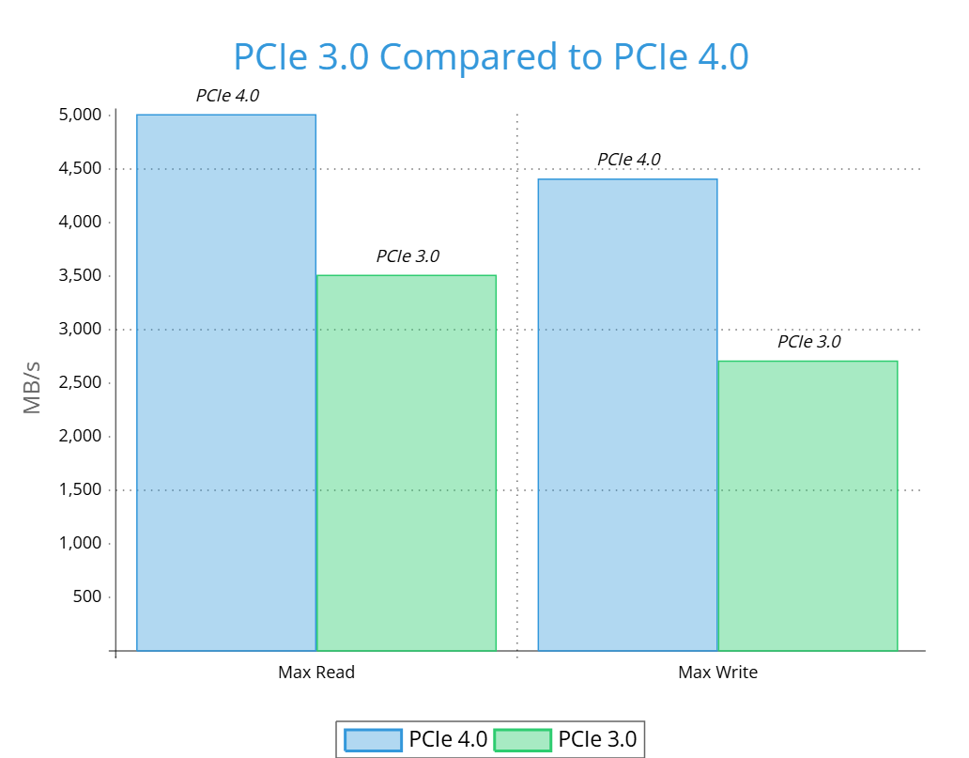
The Problem
Current Testing
SSDs are getting faster with each new generation.
Can lead to less stability.
Creates a need for better and thorough testing.
Boot Times affected
Faster load times for programs
Notes:
Explain how the business works and how it would go about testing/validating nvme ssds
Chas
SSD PCIe speeds has been rapidly growing, between the last two generations the speed have almost doubled.
This is a great thing for everyone. It means faster boot times for a computer and faster times program load times.
However, with each new generation there comes the challenges of developing new products.
There is a lot of development that is needed for each new SSD and along with that comes a lot of testing to make sure that the ssds are actually working properly.
Explain what is deficient about current testing/validation process
Charles D.
Talk about file management being faster.
This leads to faster file loading and saving.
Since SSDs are getting faster, this leads to less stability.
With this, there is a need for better and thorough testing.

Slide 3
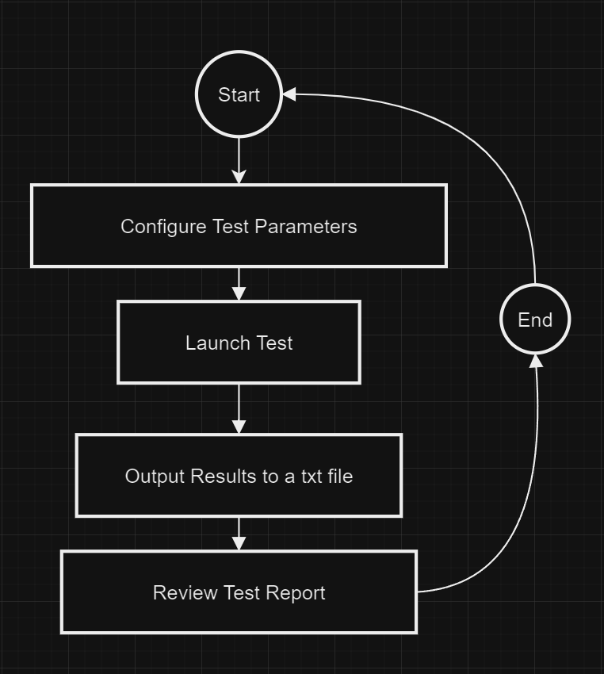
Our Solution
Generative testing
Generate or provide test key
Run that specific test case
Output result
Repeat!
Notes:
Generate test key or allow the tester to provide their own to allow for tests to be repeated, ensuing errors can be replicated and bugs have been removed
each test will iterate through states provided by the TLA+ file
the program will then output NVMe CLI output to txt file for review by the tester

Slide 4
Key Requirements
Discovering Project Requirements
Functional Requirements
Must be able to call NVMe CLI commands through Python
Must be able to parse through TLA+ files in Python
Must be able to get logging information from NVMe-CLI commands
Client Meeting
Research & Testing
TLA+ Parsing
Feedback & Discussion
TLA+ File
nvme_tla.py
nvme_cli_interface.py

Slide 5
Risks and Feasibility
Challenges
Limited test output
Deep nvme knowledge
Timeline
Feasibility
Risks
The minimum viable product is feasible with some overhead for unexpected issues given our constraints.
There are a few risks involved with NVMe validation, specifically pertaining to firmware and low level operating system issues.
Technical compatibility
Resources
Timeline
Hardware
Software
Development issues
Notes:
Risks:
Talk about why the project can be risky
Explain risks and how to mitigate them
Feasibility:
Explain why and how the project is feasible
Explain some challenges that may be associated with each feasibility aspect

Slide 6
Risks and Feasibility
 | Low Severity (0-1) | Medium Severity (2-3) | High Severity (4-5)
Low Likeliness (0-1) | Seeding (2) Power Loss (1) Power Surge (1) | Kernel Level Crashing (4) | Server Hardware Failure (6) Firmware Corruption (4) Operating System Failure (5)
Medium Likeliness (2-3) |  | Opcode Compatibility (6)
High Likeliness (4-5) |  | Opcode Validation (8)
Notes:
Risks:
Talk about why the project can be risky
Explain risks and how to mitigate them
Feasibility:
Explain why and how the project is feasible
Explain some challenges that may be associated with each feasibility aspect

Slide 7
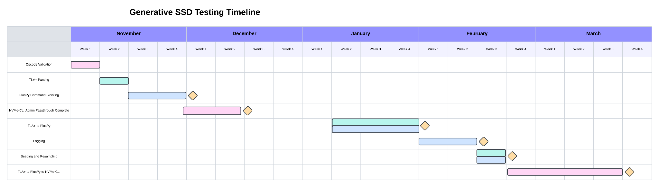
Schedule
Development Schedule
We’ve identified eight different tasks to make happen for the rest of our project’s development timeframe. There are three different focuses based on the color, which is the kind of code we are going to write.

Slide 8
Conclusion
SSDs are getting faster
  This leads to a need for better testing.
Our solution explores every path for testing of an SSD’s functionality.
  This should help find weird niche bugs.
Our solution uses TLA+, Python, and NVMe-CLI
  We connect up each part, and log it’s output.

Slide 9

Thank You!

